Slide 1

Woolworths Time Intelligence SQL Project
Michael Le

Slide 2

Requirements
Files and Sources: Main-Stuff/DA Bootcamp 2026 Emergi Mentors/Week 2 SQL Mastery/Module 3 Intermediate SQL for Analytics Professionals/Woolworths_Time_Intelligence_Analysis at main · Mikele02171/Main-Stuff
Microsoft SQL Server Express (2022 or (2025 preferred))

Slide 3
Content
Create database for Woolworths Sales
DDL: Create table daily sales
DML: Sample Data (2023,2024)
DQL: Validation Check
DQL: Date Parts
DQL: Year-over-year growth (with LAG()), Are we going compared to last year?
DQL: Month-over-Month, Did we grow this month vs last month?
DQL: Rolling Averages, Daily sales are noisy. Show me a real trend!
DQL: Quarter-over-Quarter, How does each quarter compare to the previous?
DQL: Weekend vs Weekday Comparison, How much more do we sell on weekends?
DQL: Best Performing Day of Week, Which day should we run our biggest promotions?
DQL: Month with Highest YoY Growth %, Which month grew the most year-over-year?
DQL: 30-Day Rolling Average for Online Sales, Show me online sales trend over time.
DQL: Same Day Last Year Comparison (Apples-to-Apples), How does this Monday compare to same Monday last year?
DQL: Executive Dashboard – Production Ready!

Slide 4

Create database for Woolworths Sales
-- First, switch to master to avoid "currently in use" errors
USE master;
GO
-- Drop database if exists (fresh start)
IF EXISTS (SELECT name FROM sys.databases WHERE name = 'Woolworths_Sales')
BEGIN
PRINT 'Dropping existing Woolworths_Sales database...';
ALTER DATABASE Woolworths_Sales SET SINGLE_USER WITH ROLLBACK IMMEDIATE;
DROP DATABASE Woolworths_Sales;
PRINT '✅ Existing database dropped successfully';
END
GO
-- Create fresh database
CREATE DATABASE Woolworths_Sales;
GO
USE Woolworths_Sales;
GO

Slide 5

DDL: Create table daily sales
CREATE TABLE daily_sales (
sale_date DATE PRIMARY KEY,
store_count INT,
total_revenue DECIMAL(12,2),
total_transactions INT,
average_basket_size DECIMAL(10,2),
online_revenue DECIMAL(12,2),
instore_revenue DECIMAL(12,2)
);

Slide 6
DML: Sample Data (2023) Part 1
-- Generate 2023 data (365 days)
DECLARE @date DATE = '2023-01-01';
DECLARE @counter INT = 1;
WHILE @date <= '2023-12-31'
BEGIN
INSERT INTO daily_sales VALUES (
@date,
1050, -- Woolworths has ~1050 stores in Australia
CASE
WHEN DATEPART(WEEKDAY, @date) IN (1,7) THEN 28000000 + (RAND(CHECKSUM(NEWID())) * 4000000) -- Weekend boost
WHEN MONTH(@date) = 12 THEN 32000000 + (RAND(CHECKSUM(NEWID())) * 5000000) -- December Christmas peak
ELSE 22000000 + (RAND(CHECKSUM(NEWID())) * 3000000) -- Regular weekday
END,
CASE
WHEN DATEPART(WEEKDAY, @date) IN (1,7) THEN 850000 + (RAND(CHECKSUM(NEWID())) * 100000)
WHEN MONTH(@date) = 12 THEN 950000 + (RAND(CHECKSUM(NEWID())) * 150000)
ELSE 720000 + (RAND(CHECKSUM(NEWID())) * 80000)
END,

Slide 7
DML: Sample Data (2023) Part 2
CASE
WHEN MONTH(@date) = 12 THEN 38.50 + (RAND(CHECKSUM(NEWID())) * 5)
ELSE 32.00 + (RAND(CHECKSUM(NEWID())) * 4)
END,
CASE
WHEN MONTH(@date) = 12 THEN 4500000 + (RAND(CHECKSUM(NEWID())) * 800000)
ELSE 3200000 + (RAND(CHECKSUM(NEWID())) * 500000)
END,
CASE
WHEN DATEPART(WEEKDAY, @date) IN (1,7) THEN 24000000 + (RAND(CHECKSUM(NEWID())) * 3000000)
WHEN MONTH(@date) = 12 THEN 28000000 + (RAND(CHECKSUM(NEWID())) * 4000000)
ELSE 19000000 + (RAND(CHECKSUM(NEWID())) * 2500000)
END
);
SET @date = DATEADD(DAY, 1, @date);
SET @counter = @counter + 1;
END
PRINT '✅ 2023 data inserted (365 days)';

Slide 8
DML Sample Data (2024) Part 1
SET @date = '2024-01-01';
WHILE @date <= '2024-12-31'
BEGIN
INSERT INTO daily_sales VALUES (
@date,
1050,
CASE
WHEN DATEPART(WEEKDAY, @date) IN (1,7) THEN (28000000 + (RAND(CHECKSUM(NEWID())) * 4000000)) * 1.08 -- 8% YoY growth
WHEN MONTH(@date) = 12 THEN (32000000 + (RAND(CHECKSUM(NEWID())) * 5000000)) * 1.08
ELSE (22000000 + (RAND(CHECKSUM(NEWID())) * 3000000)) * 1.08
END,
CASE
WHEN DATEPART(WEEKDAY, @date) IN (1,7) THEN (850000 + (RAND(CHECKSUM(NEWID())) * 100000)) * 1.05
WHEN MONTH(@date) = 12 THEN (950000 + (RAND(CHECKSUM(NEWID())) * 150000)) * 1.05
ELSE (720000 + (RAND(CHECKSUM(NEWID())) * 80000)) * 1.05
END,

Slide 9
DML Sample Data (2024) Part 2
CASE
WHEN MONTH(@date) = 12 THEN (38.50 + (RAND(CHECKSUM(NEWID())) * 5)) * 1.03
ELSE (32.00 + (RAND(CHECKSUM(NEWID())) * 4)) * 1.03
END,
CASE
WHEN MONTH(@date) = 12 THEN (4500000 + (RAND(CHECKSUM(NEWID())) * 800000)) * 1.15 -- Online growing faster
ELSE (3200000 + (RAND(CHECKSUM(NEWID())) * 500000)) * 1.15
END,
CASE
WHEN DATEPART(WEEKDAY, @date) IN (1,7) THEN (24000000 + (RAND(CHECKSUM(NEWID())) * 3000000)) * 1.06
WHEN MONTH(@date) = 12 THEN (28000000 + (RAND(CHECKSUM(NEWID())) * 4000000)) * 1.06
ELSE (19000000 + (RAND(CHECKSUM(NEWID())) * 2500000)) * 1.06
END
);
SET @date = DATEADD(DAY, 1, @date);
END
PRINT '✅ 2024 data inserted (366 days - leap year, 8% YoY growth built in)';
PRINT '';
GO

Slide 10

DQL: Validation Check
SELECT
COUNT(*) AS total_days,
MIN(sale_date) AS first_date,
MAX(sale_date) AS last_date,
SUM(total_revenue) / 1000000 AS total_revenue_millions
FROM daily_sales;
GO

Slide 11
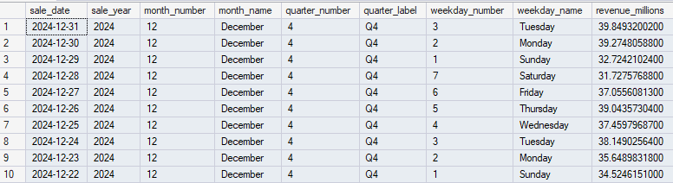
DQL: Date Parts
SELECT TOP 10
sale_date,
-- Extract time components
YEAR(sale_date) AS sale_year,
MONTH(sale_date) AS month_number,
DATENAME(MONTH, sale_date) AS month_name,
DATEPART(QUARTER, sale_date) AS quarter_number,
'Q' + CAST(DATEPART(QUARTER, sale_date) AS VARCHAR) AS quarter_label,
DATEPART(WEEKDAY, sale_date) AS weekday_number,
DATENAME(WEEKDAY, sale_date) AS weekday_name,
total_revenue / 1000000 AS revenue_millions
FROM daily_sales
ORDER BY sale_date DESC;

Slide 12
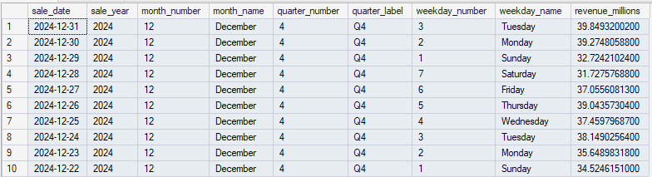
DQL: Year-over-year growth (with LAG()) Are we going compared to last year?
WITH yearly_summary AS (
SELECT
YEAR(sale_date) AS sale_year,
SUM(total_revenue) / 1000000 AS revenue_millions,
SUM(online_revenue) / 1000000 AS online_millions,
SUM(total_transactions) / 1000000 AS transactions_millions
FROM daily_sales
GROUP BY YEAR(sale_date)
)
SELECT
sale_year,
revenue_millions,
transactions_millions,
online_millions,
-- Previous year (LAG function)
LAG(revenue_millions) OVER (ORDER BY sale_year) AS previous_year_revenue,
-- YoY growth in dollars
revenue_millions - LAG(revenue_millions) OVER (ORDER BY sale_year) AS yoy_growth_amount,
-- YoY growth percentage
ROUND(((revenue_millions - LAG(revenue_millions) OVER (ORDER BY sale_year))
/ LAG(revenue_millions) OVER (ORDER BY sale_year)) * 100, 2) AS yoy_percent,
-- Online penetration %
ROUND((online_millions / revenue_millions) * 100, 1) AS online_penetration_percent
FROM yearly_summary
ORDER BY sale_year;

Slide 13
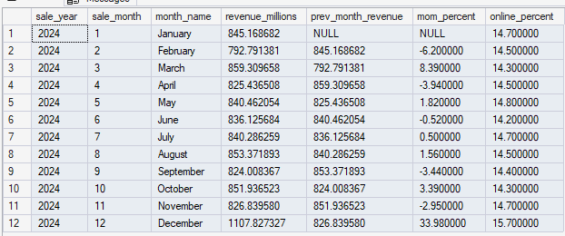
DQL: Month-over-Month Did we grow this month vs last month?
WITH monthly_summary AS (
SELECT
YEAR(sale_date) AS sale_year,
MONTH(sale_date) AS sale_month,
DATENAME(MONTH, sale_date) AS month_name,
SUM(total_revenue) / 1000000 AS revenue_millions,
SUM(online_revenue) / 1000000 AS online_millions
FROM daily_sales
GROUP BY YEAR(sale_date), MONTH(sale_date), DATENAME(MONTH, sale_date)
)
SELECT
sale_year,
sale_month,
month_name,
revenue_millions,
-- Previous month
LAG(revenue_millions) OVER (ORDER BY sale_year, sale_month) AS prev_month_revenue,
-- MoM growth %
ROUND(((revenue_millions - LAG(revenue_millions) OVER (ORDER BY sale_year, sale_month))
/ LAG(revenue_millions) OVER (ORDER BY sale_year, sale_month)) * 100, 2) AS mom_percent,
-- Online %
ROUND((online_millions / revenue_millions) * 100, 1) AS online_percent
FROM monthly_summary
WHERE sale_year = 2024
ORDER BY sale_year, sale_month;

Slide 14
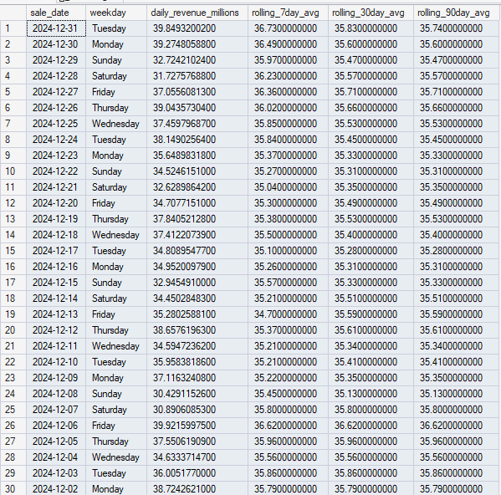
DQL: Rolling Averages Daily sales are noisy. Show me a real trend!
SELECT TOP 30
sale_date,
DATENAME(WEEKDAY, sale_date) AS weekday,
total_revenue / 1000000 AS daily_revenue_millions,
-- 7-day rolling average
ROUND(AVG(total_revenue / 1000000) OVER (
ORDER BY sale_date
ROWS BETWEEN 6 PRECEDING AND CURRENT ROW
), 2) AS rolling_7day_avg,
-- 30-day rolling average
ROUND(AVG(total_revenue / 1000000) OVER (
ORDER BY sale_date
ROWS BETWEEN 29 PRECEDING AND CURRENT ROW
), 2) AS rolling_30day_avg,
-- 90-day rolling average (quarterly trend)
ROUND(AVG(total_revenue / 1000000) OVER (
ORDER BY sale_date
ROWS BETWEEN 89 PRECEDING AND CURRENT ROW
), 2) AS rolling_90day_avg
FROM daily_sales
WHERE sale_date >= '2024-12-01'
ORDER BY sale_date DESC;

Slide 15
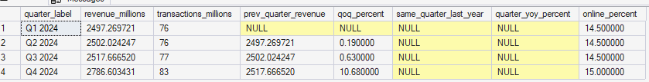
DQL: Quarter-over-Quarter How does each quarter compare to the previous?
WITH quarterly_summary AS (
SELECT
YEAR(sale_date) AS sale_year,
DATEPART(QUARTER, sale_date) AS quarter_number,
'Q' + CAST(DATEPART(QUARTER, sale_date) AS VARCHAR) + ' ' + CAST(YEAR(sale_date) AS VARCHAR) AS quarter_label,
SUM(total_revenue) / 1000000 AS revenue_millions,
SUM(total_transactions) / 1000000 AS transactions_millions,
SUM(online_revenue) / 1000000 AS online_millions
FROM daily_sales
GROUP BY YEAR(sale_date), DATEPART(QUARTER, sale_date)
)
SELECT
quarter_label,
revenue_millions,
transactions_millions,
-- Previous quarter
LAG(revenue_millions) OVER (ORDER BY sale_year, quarter_number) AS prev_quarter_revenue,
-- QoQ growth %
ROUND(((revenue_millions - LAG(revenue_millions) OVER (ORDER BY sale_year, quarter_number))
/ LAG(revenue_millions) OVER (ORDER BY sale_year, quarter_number)) * 100, 2) AS qoq_percent,
-- Same quarter last year
LAG(revenue_millions, 4) OVER (ORDER BY sale_year, quarter_number) AS same_quarter_last_year,
-- YoY growth for quarter
ROUND(((revenue_millions - LAG(revenue_millions, 4) OVER (ORDER BY sale_year, quarter_number))
/ LAG(revenue_millions, 4) OVER (ORDER BY sale_year, quarter_number)) * 100, 2) AS quarter_yoy_percent,
-- Online penetration
ROUND((online_millions / revenue_millions) * 100, 1) AS online_percent
FROM quarterly_summary
WHERE sale_year = 2024
ORDER BY sale_year, quarter_number;

Slide 16
DQL: Weekend vs Weekday Comparison How much more do we sell on weekends?
WITH daily_categorized AS (
SELECT
sale_date,
DATENAME(WEEKDAY, sale_date) AS weekday_name,
DATEPART(WEEKDAY, sale_date) AS weekday_number,
CASE
WHEN DATEPART(WEEKDAY, sale_date) IN (1,7) THEN 'Weekend'
ELSE 'Weekday'
END AS day_category,
total_revenue / 1000000 AS revenue_millions,
total_transactions
FROM daily_sales
WHERE YEAR(sale_date) = 2024
)
SELECT
day_category,
COUNT(*) AS number_of_days,
ROUND(AVG(revenue_millions), 2) AS avg_revenue_millions,
ROUND(MIN(revenue_millions), 2) AS min_revenue_millions,
ROUND(MAX(revenue_millions), 2) AS max_revenue_millions,
ROUND(AVG(total_transactions), 0) AS avg_transactions,
ROUND(AVG(revenue_millions) / AVG(total_transactions) * 1000000, 2) AS avg_transaction_value
FROM daily_categorized
GROUP BY day_category
ORDER BY avg_revenue_millions DESC;

Slide 17
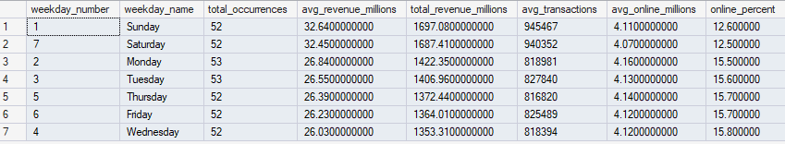
DQL: Best Performing Day of Week Which day should we run our biggest promotions?
WITH daily_performance AS (
SELECT
DATEPART(WEEKDAY, sale_date) AS weekday_number,
DATENAME(WEEKDAY, sale_date) AS weekday_name,
total_revenue / 1000000 AS revenue_millions,
total_transactions,
online_revenue / 1000000 AS online_millions
FROM daily_sales
WHERE YEAR(sale_date) = 2024
)
SELECT
weekday_number,
weekday_name,
COUNT(*) AS total_occurrences,
ROUND(AVG(revenue_millions), 2) AS avg_revenue_millions,
ROUND(SUM(revenue_millions), 2) AS total_revenue_millions,
ROUND(AVG(total_transactions), 0) AS avg_transactions,
ROUND(AVG(online_millions), 2) AS avg_online_millions,
ROUND((AVG(online_millions) / AVG(revenue_millions)) * 100, 1) AS online_percent
FROM daily_performance
GROUP BY weekday_number, weekday_name
ORDER BY avg_revenue_millions DESC;

Slide 18
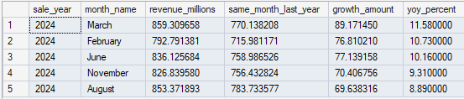
DQL: Month with Highest YoY Growth % Which month grew the most year-over-year?
WITH monthly_yoy AS (
SELECT
YEAR(sale_date) AS sale_year,
MONTH(sale_date) AS sale_month,
DATENAME(MONTH, sale_date) AS month_name,
SUM(total_revenue) / 1000000 AS revenue_millions
FROM daily_sales
GROUP BY YEAR(sale_date), MONTH(sale_date), DATENAME(MONTH, sale_date)
),
yoy_calculated AS (
SELECT
sale_year,
sale_month,
month_name,
revenue_millions,
LAG(revenue_millions, 12) OVER (ORDER BY sale_year, sale_month) AS same_month_last_year,
ROUND(((revenue_millions - LAG(revenue_millions, 12) OVER (ORDER BY sale_year, sale_month))
/ LAG(revenue_millions, 12) OVER (ORDER BY sale_year, sale_month)) * 100, 2) AS yoy_percent
FROM monthly_yoy
)
SELECT TOP 5
sale_year,
month_name,
revenue_millions,
same_month_last_year,
revenue_millions - same_month_last_year AS growth_amount,
yoy_percent
FROM yoy_calculated
WHERE sale_year = 2024 AND same_month_last_year IS NOT NULL
ORDER BY yoy_percent DESC;

Slide 19
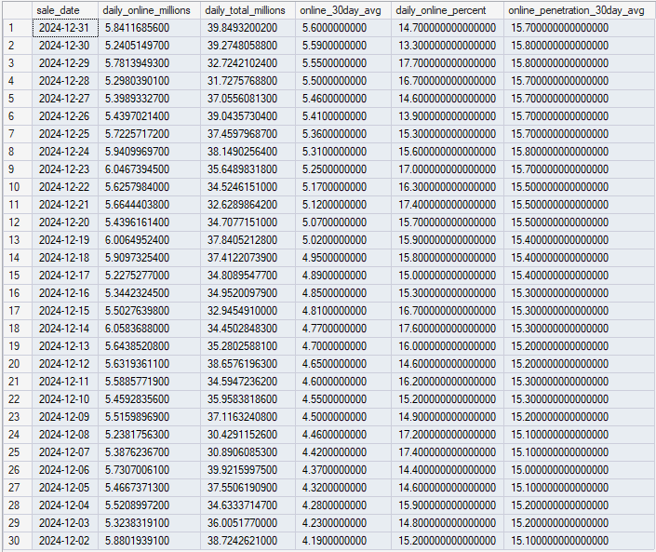
DQL: 30-Day Rolling Average for Online Sales Show me online sales trend over time.
SELECT TOP 30
sale_date,
online_revenue / 1000000 AS daily_online_millions,
total_revenue / 1000000 AS daily_total_millions,
-- 30-day rolling average for online
ROUND(AVG(online_revenue / 1000000) OVER (
ORDER BY sale_date
ROWS BETWEEN 29 PRECEDING AND CURRENT ROW
), 2) AS online_30day_avg,
-- Online penetration daily
ROUND((online_revenue / total_revenue) * 100, 1) AS daily_online_percent,
-- 30-day rolling average penetration
ROUND(AVG((online_revenue / total_revenue) * 100) OVER (
ORDER BY sale_date
ROWS BETWEEN 29 PRECEDING AND CURRENT ROW
), 1) AS online_penetration_30day_avg
FROM daily_sales
WHERE sale_date >= '2024-11-01'
ORDER BY sale_date DESC;

Slide 20
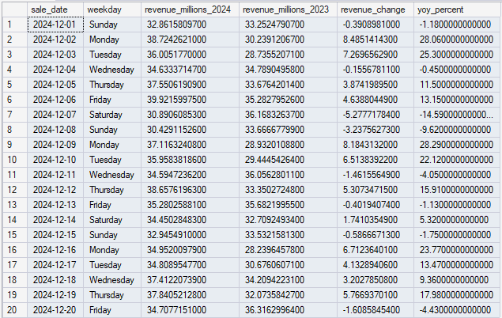
DQL: Same Day Last Year Comparison (Apples-to-Apples) How does this Monday compare to same Monday last year?
WITH current_year AS (
SELECT
sale_date,
DATENAME(WEEKDAY, sale_date) AS weekday,
total_revenue / 1000000 AS revenue_millions_2024
FROM daily_sales
WHERE YEAR(sale_date) = 2024
),
previous_year AS (
SELECT
DATEADD(YEAR, 1, sale_date) AS sale_date, -- Shift 2023 dates forward 1 year
total_revenue / 1000000 AS revenue_millions_2023
FROM daily_sales
WHERE YEAR(sale_date) = 2023
)
SELECT TOP 20
c.sale_date,
c.weekday,
c.revenue_millions_2024,
p.revenue_millions_2023,
c.revenue_millions_2024 - p.revenue_millions_2023 AS revenue_change,
ROUND(((c.revenue_millions_2024 - p.revenue_millions_2023) / p.revenue_millions_2023) * 100, 2) AS yoy_percent
FROM current_year c
LEFT JOIN previous_year p ON c.sale_date = p.sale_date
WHERE c.sale_date >= '2024-12-01'
ORDER BY c.sale_date;

Slide 21
DQL: Executive Dashboard Production Ready! Part 1
WITH monthly_metrics AS (
SELECT
YEAR(sale_date) AS sale_year,
MONTH(sale_date) AS sale_month,
DATENAME(MONTH, sale_date) AS month_name,
SUM(total_revenue) / 1000000 AS revenue_millions,
SUM(total_transactions) / 1000000 AS transactions_millions,
AVG(average_basket_size) AS avg_basket,
SUM(online_revenue) / 1000000 AS online_revenue_millions
FROM daily_sales
GROUP BY YEAR(sale_date), MONTH(sale_date), DATENAME(MONTH, sale_date)
)
SELECT
sale_year,
sale_month,
month_name,
revenue_millions,
transactions_millions,
avg_basket,
online_revenue_millions,

Slide 22
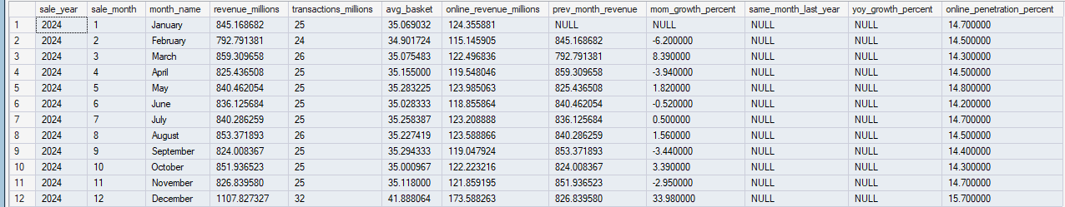
DQL: Executive Dashboard Production Ready! Part 2
-- Previous month comparison (MoM)
LAG(revenue_millions) OVER (ORDER BY sale_year, sale_month) AS prev_month_revenue,
ROUND(((revenue_millions - LAG(revenue_millions) OVER (ORDER BY sale_year, sale_month))
/ LAG(revenue_millions) OVER (ORDER BY sale_year, sale_month)) * 100, 2) AS mom_growth_percent,
-- Same month last year comparison (YoY)
LAG(revenue_millions, 12) OVER (ORDER BY sale_year, sale_month) AS same_month_last_year,
ROUND(((revenue_millions - LAG(revenue_millions, 12) OVER (ORDER BY sale_year, sale_month))
/ LAG(revenue_millions, 12) OVER (ORDER BY sale_year, sale_month)) * 100, 2) AS yoy_growth_percent,
-- Online penetration %
ROUND((online_revenue_millions / revenue_millions) * 100, 1) AS online_penetration_percent
FROM monthly_metrics
WHERE sale_year = 2024
ORDER BY sale_year, sale_month;

